Slide 1
Introduction To Design Patterns

Slide 2
CONTENTS
01
Introduction
02
Creational Design Patterns
03
Behavioral Design Patterns
04
Structural Design Patterns

Slide 3
01
Introduction
Design Patterns: what is it and why?
Pattern elements
Design Pattern Types

Slide 4
Design Patterns: what is it and why?
Design patterns are typical solutions to common problems in software design. Each pattern is like a blueprint that you can customize to solve a particular design problem in your code.
You can’t just find a pattern and copy it into your program, The pattern is not a specific piece of code, but a general concept for solving a particular problem
a pattern is a more high-level description of a solution. The code of the same pattern applied to two different programs may be different.
Design patterns define a common language that you and your teammates can use to communicate more efficiently.

Slide 5
Pattern elements
Name and definition
Problem description
Solution description
Code Example

Slide 6
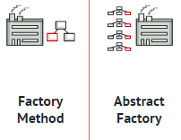
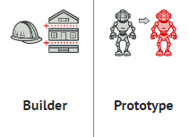
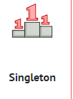
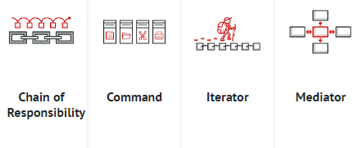
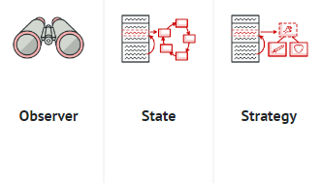
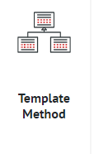
The Catalog Of Design Patterns
Creational Patterns
These patterns provide various object creation mechanisms, which increase flexibility
and reuse of existing code.
Behavioral Patterns
These patterns are concerned with algorithms and the assignment of responsibilities
between objects.

Slide 7
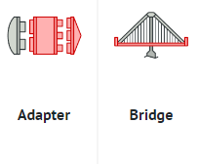
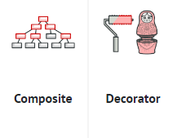
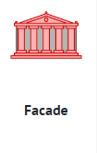
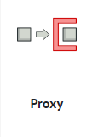
The Catalog Of Design Patterns
Structural Patterns
These patterns explain how to assemble objects and classes into larger structures while keeping these structures flexible and efficient.

Slide 8
02
Creational Patterns
Factory pattern
Abstract factory pattern
Singleton

Slide 9
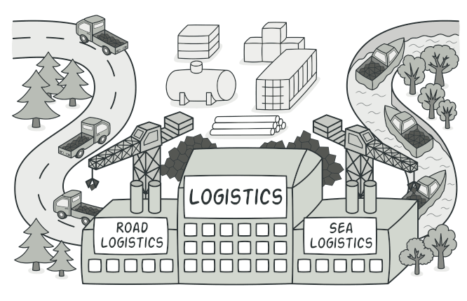
Factory Pattern (definition)
Factory is a creational design pattern that provides an interface for creating objects
Factory simple code that hides or wraps the new keyword to another way

Slide 10
Factory Pattern (problem)
“coupling” of the client code that uses a class
having multiple new(MyObject) calls round the code base, you keep the initialization in one place, satisfying the Don’t Repeat Yourself (DRY) principle.
Break single responsibility principle

Slide 11
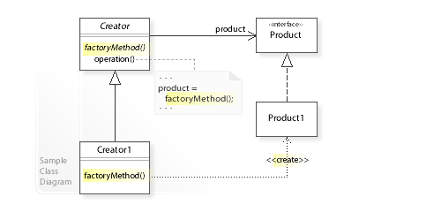
Factory Pattern (solution)
The Factory Method pattern suggests that you replace direct object construction calls
(using the new operator) with calls to a special factory method.

Slide 12
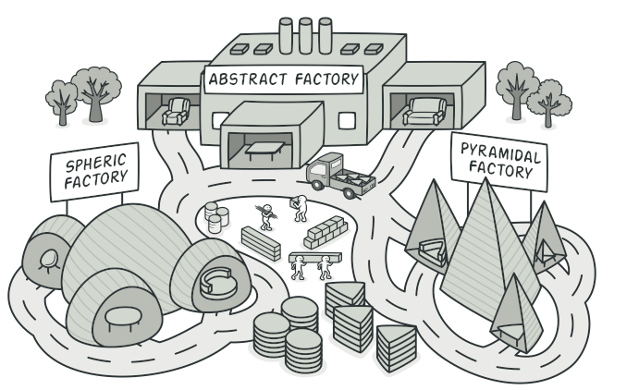
Abstract Factory Pattern (definition)
Abstract Factory is a creational design pattern that lets you produce families of related objects .

Slide 13
Abstract Factory Pattern (problem)
The problems solved by abstract factory are similar to those solved by the factory method pattern, but with greater abstraction in the types of objects that need to be created
in the case of abstract factory, it is required to work with several families of products related to each other rather than in a set of products.

Slide 14
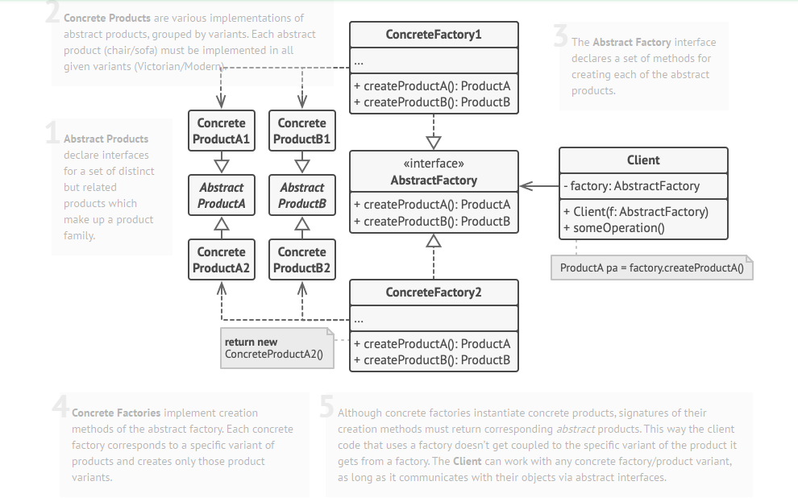
Abstract Factory Pattern (solution)
the Abstract Factory pattern suggests is to explicitly declare factories for each distinct product of the product family

Slide 15
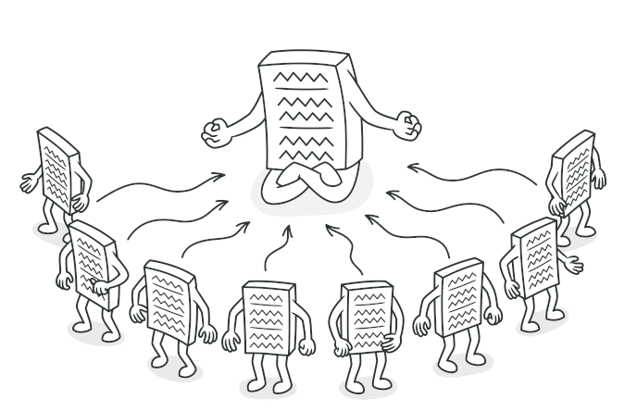
Singleton (definition)
Singleton is a creational design pattern that lets you ensure that a class has only one instance, while providing a global access point to this instance.

Slide 16
Singleton (problem)
Ensure that a class has just a single instance to control access to some shared resource—for example, a database or a file.
Provide a global access point to that instance.

Slide 17
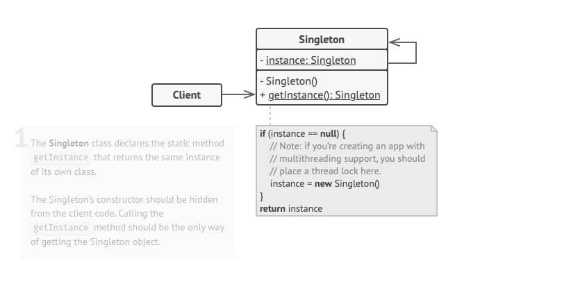
Singleton (solution)
Make the default constructor private, to prevent other objects from using the new operator with the Singleton class.
Create a static creation method that acts as a constructor. his method calls the private constructor to create an object and saves it in a static field. All following calls to this method return the cached object.

Slide 18
03
Structural Patterns
adapter
decorator
Façade
proxy

Slide 19
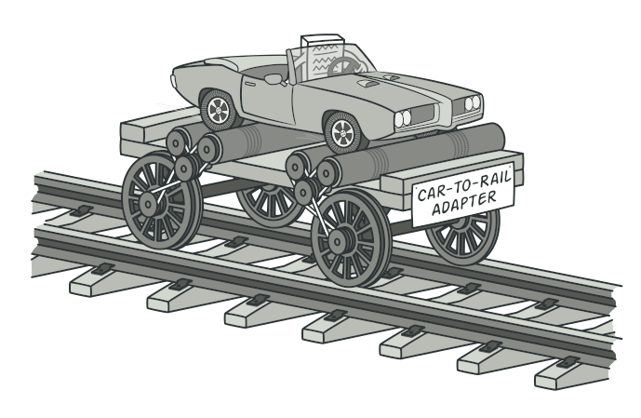
Adapter (definition)
Adapter is a design pattern that allows objects with incompatible interfaces to collaborate
The object that joins these unrelated interfaces is called an Adapter

Slide 20
Adapter (problem)
Can’t a reuse class that does not have an interface that a client requires
Classes that have incompatible interfaces can’t work together

Slide 21
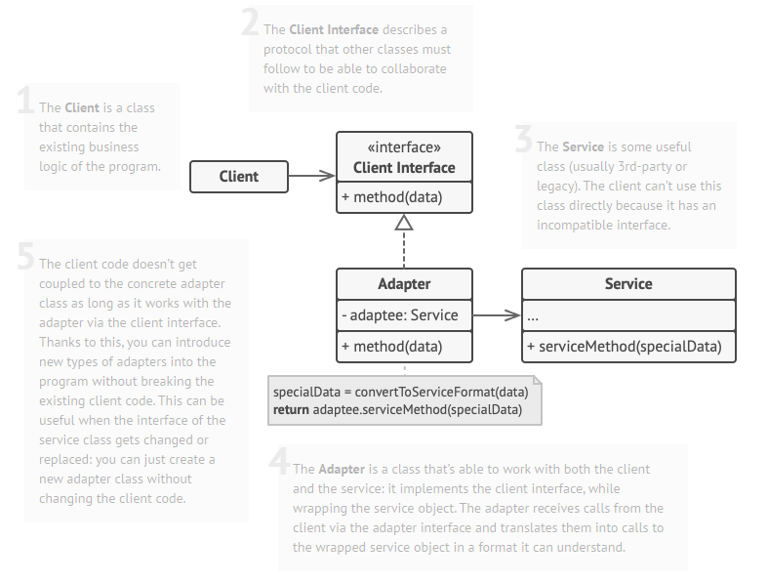
Adapter (solution)
You can create an adapter. This is a special object that converts the interface of one object so that another object can understand it.

Slide 22
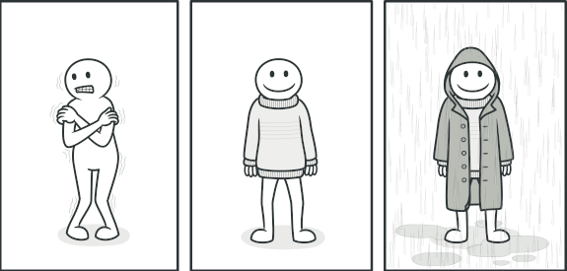
Decorator (definition)
Decorator is a structural design pattern that lets you attach new behaviors to objects by placing these objects inside special wrapper objects that contain the behaviors.

Slide 23
Decorator (problem)
The need to modify the functionality of an object at runtime.
At the same time other instances of the same class will not be affected by this

Slide 24
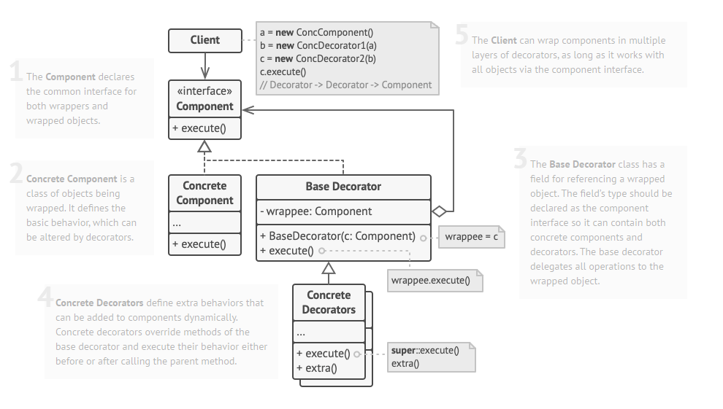
Decorator (solution)
using Aggregation or Composition instead of Inheritance.
Both of the alternatives work almost the same way: one object has a reference to another and delegates it some work,

Slide 25
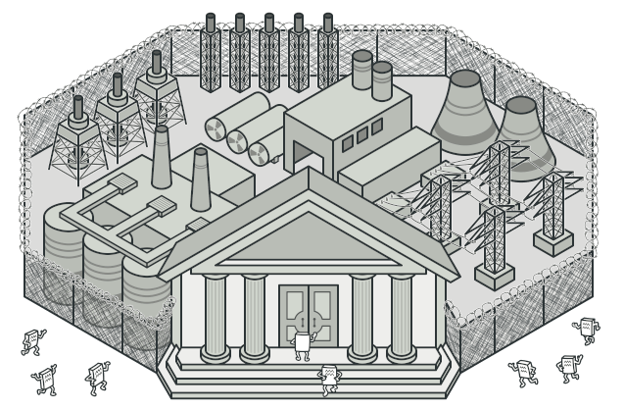
Facade (definition)
Facade is a structural design pattern that provides a simplified interface to a library,
a framework, or any other complex set of classes.
Facade design pattern is used to help client applications to easily interact with the system.

Slide 26
Facade (problem)
when a system is very complex or difficult to understand.
when the number of interfaces grow and system gets complex

Slide 27
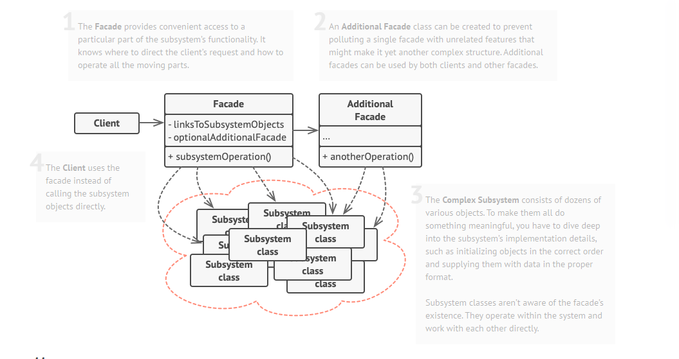
Facade (solution)
Provide a unified interface to a set of interfaces in a subsystem
Provide limited functionality it includes only those features that clients really care about.

Slide 28
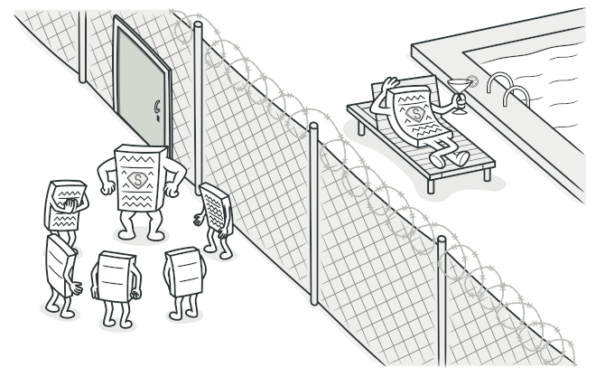
Proxy (definition)
Proxy is a structural design pattern that lets you provide a substitute or placeholder for another object. A proxy controls access to the original object to control access to it.

Slide 29
Proxy (problem)
You need to support resource objects, and you do not want to instantiate such objects unless and until they are actually requested by the client.
You want to provide controlled access of a functionality.

Slide 30
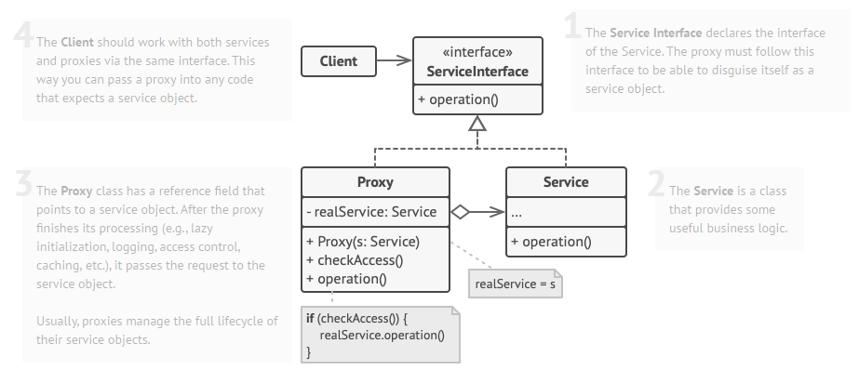
Proxy (solution)
The Proxy pattern suggests that you create a new proxy class with the same interface as an original service object
Upon receiving a request from a client, the proxy creates a real service object and delegates all the work to it.

Slide 31
04
Behavioral Patterns
Observer Pattern
Template Pattern
Strategy Pattern
State Pattern

Slide 32
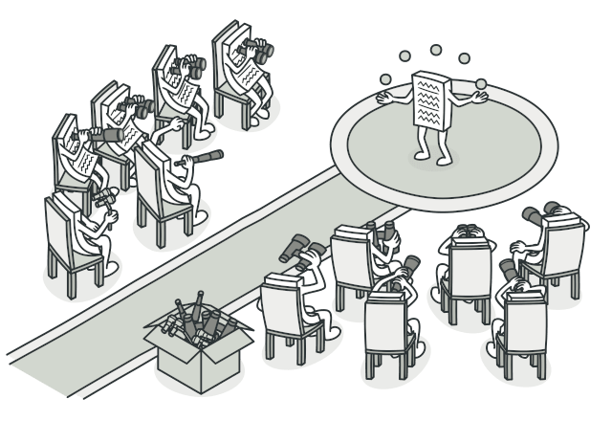
Observer Pattern (definition)
Observer is a behavioral design pattern that lets you define a subscription mechanism to notify multiple objects about any events that happen to the object they’re observing.
In observer pattern, the object that watch on the state of another object are called Observer
and the object that is being watched is called Subject.

Slide 33
Observer (problem)
A one-to-many dependency between objects should be defined without making the objects
tightly coupled.
When one object changes state, an open-ended number of dependent objects should be updated automatically.

Slide 34
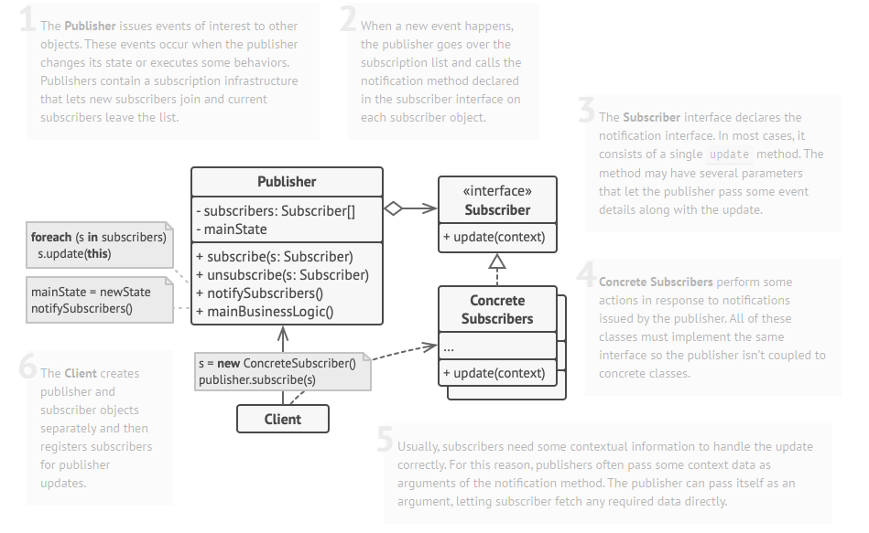
Observer Solution (solution)
Add a subscription mechanism to the publisher class so individual objects can subscribe to or unsubscribe from a stream of events coming from that publisher.

Slide 35
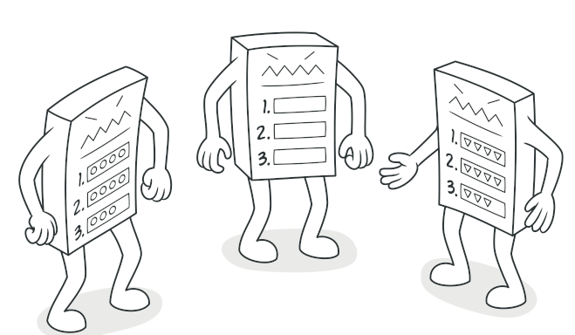
Template Pattern (definition)
Template method defines the steps to execute an algorithm and it can provide default
implementation that might be common for all or some of the subclasses.

Slide 36
Template (problem)
Need to use of an algorithm which has different variations.
How do I build a set of objects that all follow the same algorithm, but which vary the implementation of particular steps in that algorithm.

Slide 37
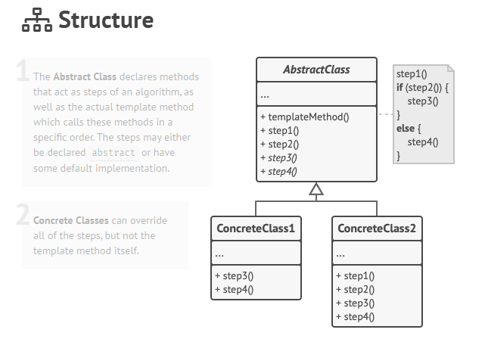
Template Solution (solution)
break down an algorithm into a series of steps, turn these steps into methods, and put a series of calls to these methods inside a single template method.

Slide 38
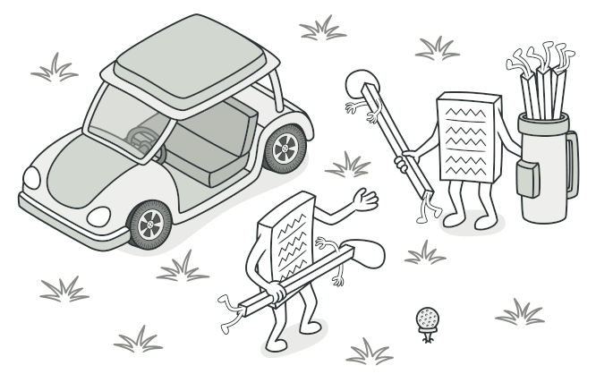
Strategy Pattern (definition)
Strategy is a behavioral design pattern that lets you define a family of algorithms, put each of
them into a separate class, and make their objects interchangeable.

Slide 39
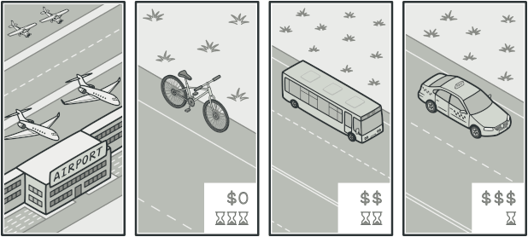
Strategy (problem)
We have multiple algorithm for a specific task and client decides the actual implementation to
be used at runtime..

Slide 40
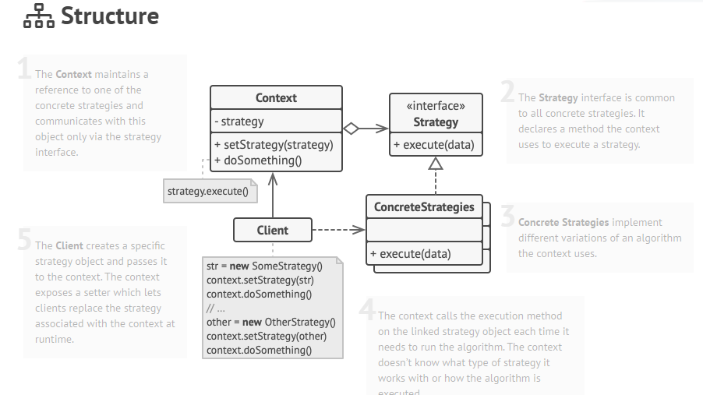
Strategy Solution (solution)
take a class that does something specific in a lot of different ways and extract all of these
algorithms into separate classes called strategies.

Slide 41
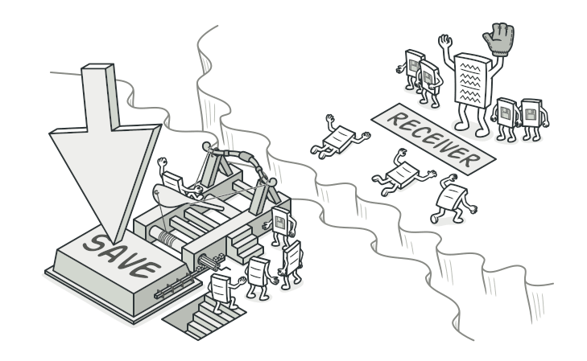
Command Pattern (definition)
Command: A request is wrapped under an object as command and passed to invoker object. Invoker object looks for the appropriate object which can handle this command and passes the command to the corresponding object which executes the command.

Slide 42
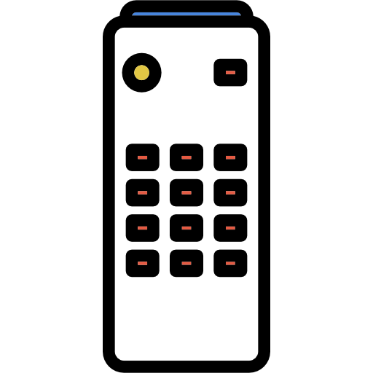
Command (problem)
Coupling the invoker of a request to a particular request should be avoided.
Undoing and redoing to be implementable
The invoker issues commands without knowing anything about the receiver

Slide 43
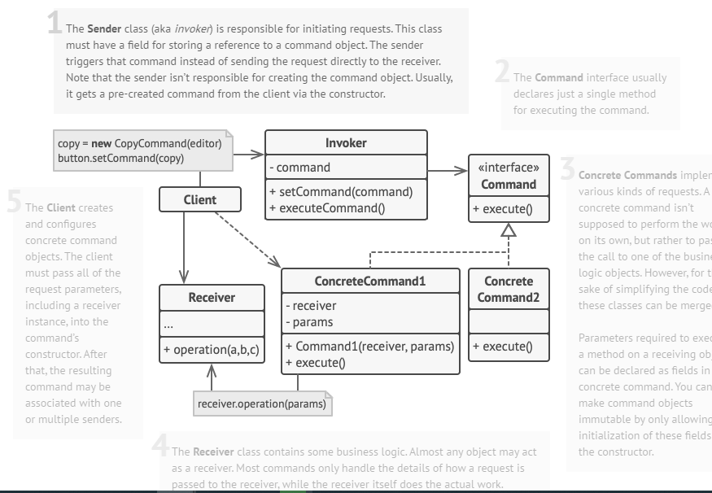
Command Solution (solution)
We can create command classes that represent the operations that can be invoked on a receiver. We hide the receiver and method details within each concrete command class. The invoker can issue these commands without knowing anything about the receiver or the exact methods.

Slide 44
References
https://refactoring.guru/design-patterns
https://app.pluralsight.com/library/courses/design-patterns-java-creational/table-of-contents
https://app.pluralsight.com/library/courses/design-patterns-java-structural/table-of-contents
https://app.pluralsight.com/library/courses/design-patterns-java-behavioral/table-of-contents

Slide 45
THANK YOU

